Slide 1
CRIME MANAGEMENT SYSTEM
Vineetha S
22PMC158

Slide 2

ABSTRACT
The Crime Management System is an integrated web-based platform designed to facilitate efficient management of crime-related activities and provide support for law enforcement agencies and users. It aims to streamline the process of reporting crimes, managing complaints, and maintaining criminal records. The system incorporates features such as profile management, police details, complaint and crime reporting, news uploading, complaint status updates, criminal detail management, and user support.

Slide 3
REQUIREMENTS
News Uploading
Criminal Detail Management
Receive Complaints and Update status
Profile Management
Complaint and Crime Reporting
User Support
Add Police Details

Slide 4
FEATURES AND HIGHLIGHTS
Authorized police can upload news updates related to criminal activities, investigations, and other relevant information. Comprehensive database to manage and store criminal details, including personal profiles, criminal records, photographs and other relevant data.
Users can submit complaints regarding criminal activities through the system, which are recorded and assigned to respective police station.
Authorized police can update the status of complaints, providing regular updates to users about the progress of their cases.
Users and police can manage their profiles by updating personal information, contact details .
Admin can add and manage police officer details, including personal information and rank.

Slide 5
TECHNICAL ASPECTS
Django Framework: Django is the web application framework used in building the crime management system which is written in Python programming language. It is based on MVT (Model View Template) design pattern.
Python: Python is an interpreted, object-oriented, high-level programming language with dynamic semantics. Its high-level built in data structures, combined with dynamic typing and dynamic binding, make it very attractive for Rapid Application.
HTML/CSS/JavaScript :This project is developed using HTML, CSS, and JavaScript as the front-end technologies .
Database Management System SQLite is a lightweight and self-contained relational database management system used in this project.

Slide 6

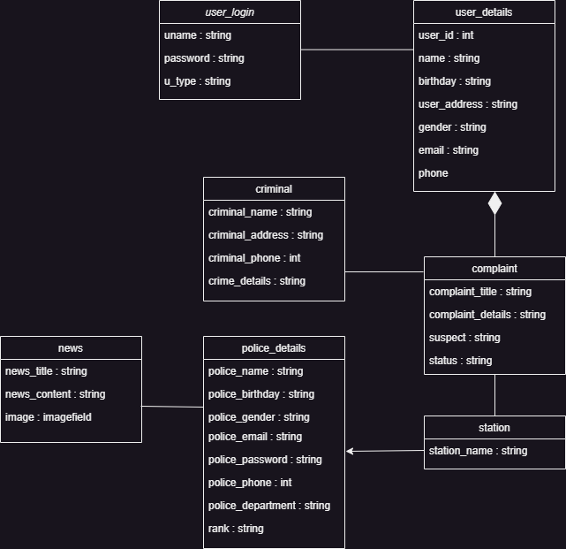
CLASS DIAGRAM

Slide 7
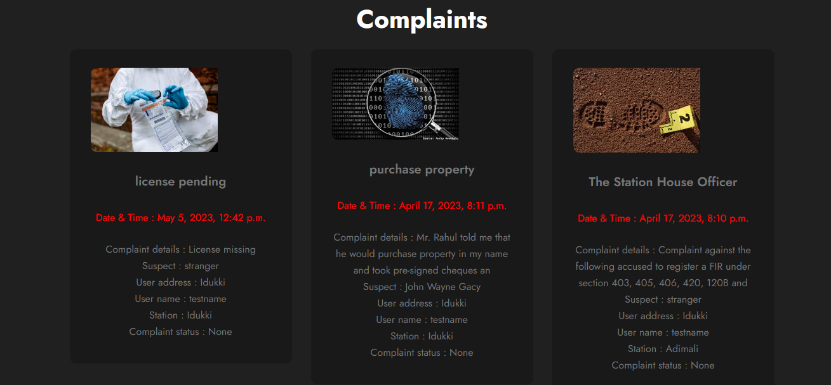
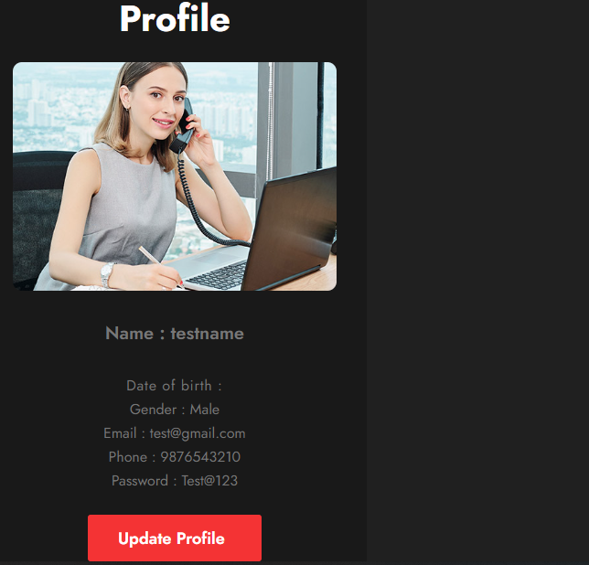
User viewing registered complaints
User viewing profile

Slide 8
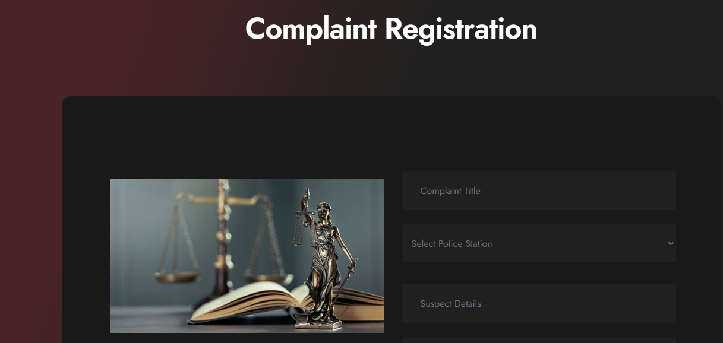
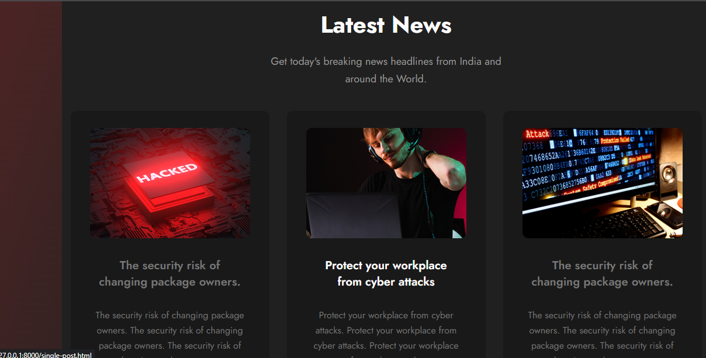
User complaint register
User view latest news

Slide 9
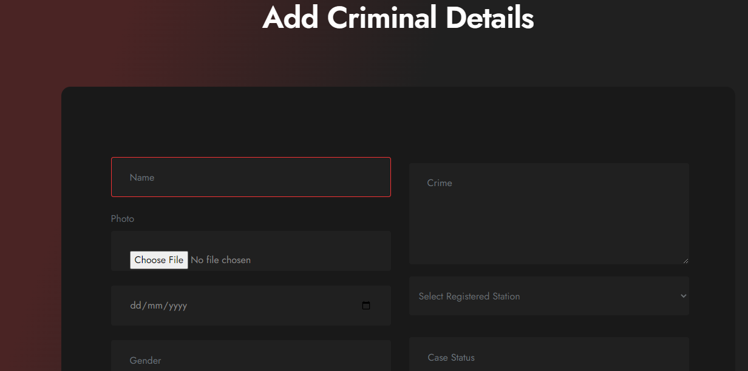
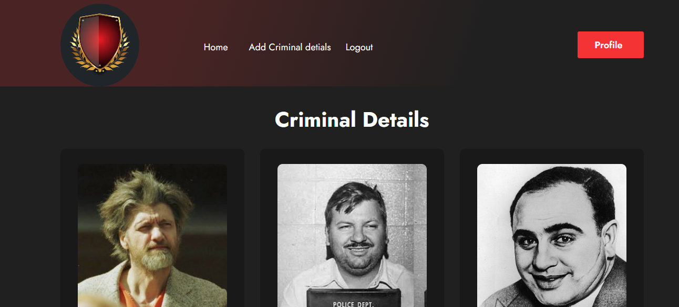
Police add criminal details
Police view Criminal details

Slide 10
THIRD-PARTY LIBRARIES
Bootstrap :Bootstrap is the most popular CSS Framework for developing responsive and mobile-first websites.
jQuery :Python is an interpreted, object-oriented, high-level programming language with dynamic semantics. Its high-level built in data structures, combined with dynamic typing and dynamic binding, make it very attractive for Rapid Application.
Django Jazzmin :A drop-in app to jazz up your Django admin site, with plenty of things you can easily customize, including a built-in UI customizer
SQLite is a lightweight and self-contained relational database management system used in this project.

Slide 11
ARCHITECTURE
Models
The models define the data structures and relationships within the crime management system.
Views/View Models
Views or view models handle the business logic data flow between the models and templates. They handle user requests, retrieve data from the database, and prepare the data for rendering in the templates.
Templates
Templates contain the HTML/CSS structure and presentation logic for rendering the user interface. They are responsible for displaying the data fetched from the views and rendering it in a user-friendly format. Routers
Routers handle the URL routing and map the incoming requests to the appropriate views or view models. They define the endpoints and HTTP methods for handling user requests.

Slide 12
CHALLENGES FACED
The major challenge faced by me was to plan the process flow of the project. While coming to the coding part I had difficulties in updating the user profile. The next major challenge which I faced was during the project was Designing an intuitive and user-friendly interface that accommodates all the required functionalities can be challenging. Balancing the complexity of the system with a simple and intuitive user experience is essential for user satisfaction and adoption. Validating user input and ensuring data integrity is essential to maintain accurate and reliable information. Implementing proper validation checks, handling edge cases, and preventing data inconsistencies or corruption was challenges .

Slide 13
FUTURE ENHANCEMENTS
Capturing image of criminals using web came: While adding criminal details by police , police should be able to capture criminal’s picture using web came capture.
Identify criminal : Including machine learning to identify criminals.

Slide 14
CONCLUSION
The Crime Management System is a web-based software application designed to facilitate efficient and organized management of crime-related information. It serves as a valuable tool for managing news uploads, criminal details, complaints, and profiles, providing a reliable platform for reporting and addressing complaints and crimes within the specified domain.

Slide 15

REFERENCE
https://docs.djangoproject.com/en/4.2/
https://keralapolice.gov.in/
https://getbootstrap.com/docs/4.0/getting-started/introduction/

